Slide 1
Chapter 13 Programming Languages and Program Development

Slide 2
Chapter 13 Objectives
Describe various ways to develop Web pages including HTML, scripting languages, DHTML, XML, WML, and Web page authoring software
Differentiate between machine and assembly languages
Identify the uses of popular multimedia authoring programs
Identify and discuss the purpose of procedural programming languages
List the six steps in the program development cycle
Identify and discuss the characteristics of object-oriented programming languages and program development tools
Differentiate between structured design and object-oriented design
Identify the uses of other programming languages and other program development tools
Explain the basic control structures and design tools used in designing solutions to programming problems
Next

Slide 3

Computer Programs and Programming Languages
What is a computer program?
Series of instructions that directs computer to perform tasks
Programming language—used to communicate instructions
p. 664 Fig. 13-1
Next

Slide 4
Computer Programs and Programming Languages
What are low-level languages and high-level languages?
Low-level language
High-level language
Machine-dependent runs only on one type of computer
Often machine-independent can run on many different types of computers and operating systems
Machine and assembly languages are low-level
p. 664 - 665
Next

Slide 5
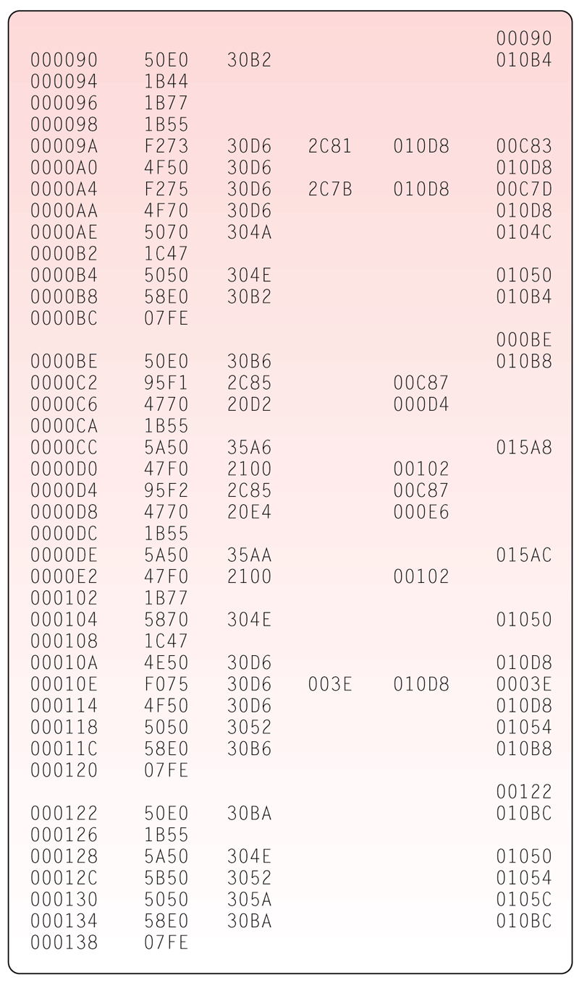
Low-Level Languages
What is machine language?
Only language computer directly recognizes
Uses a series of binary digits (1s and 0s) with a combination of numbers and letters that represent binary digits
p. 665 Fig. 13-2
Next

Slide 6
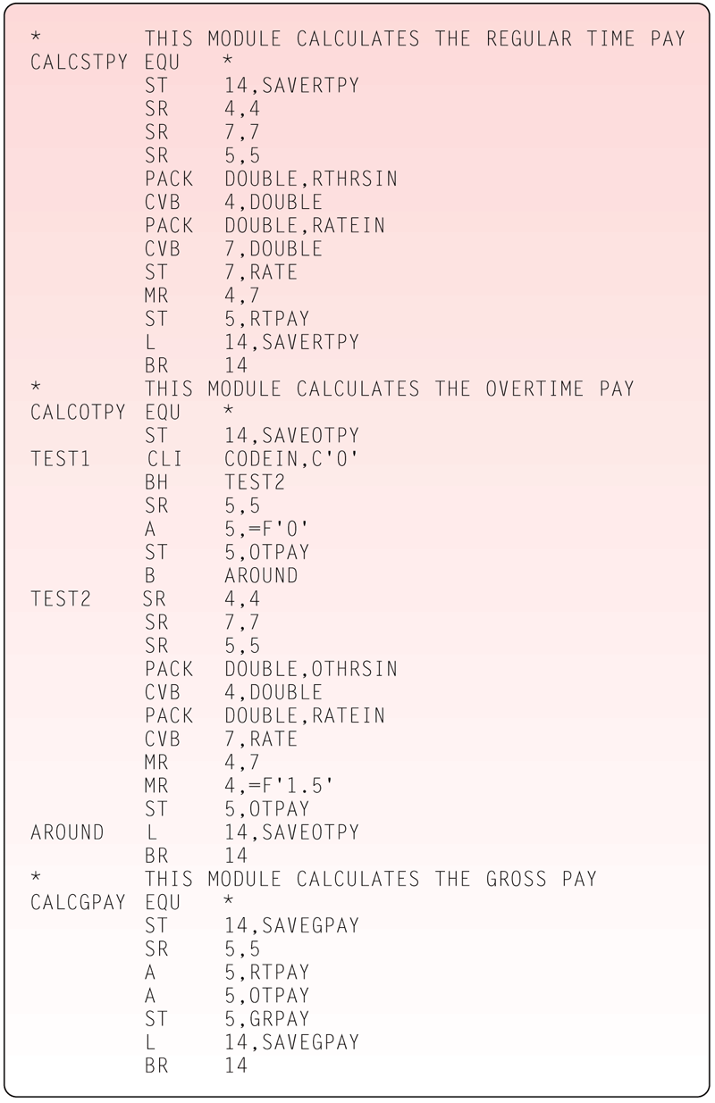
Low-Level Languages
What is assembly language?
Instructions made up of symbolic instruction codes, meaningful abbreviations and codes
Source program contains code to be converted to machine language
p. 666 Fig. 13-3
Next

Slide 7
Procedural Languages
What is a procedural language?
Programmer writes instructions that tell computer what to accomplish and how to do it
Uses series of English-like words to write instructions
Often called third-generation language (3GL)
p. 666
Next

Slide 8
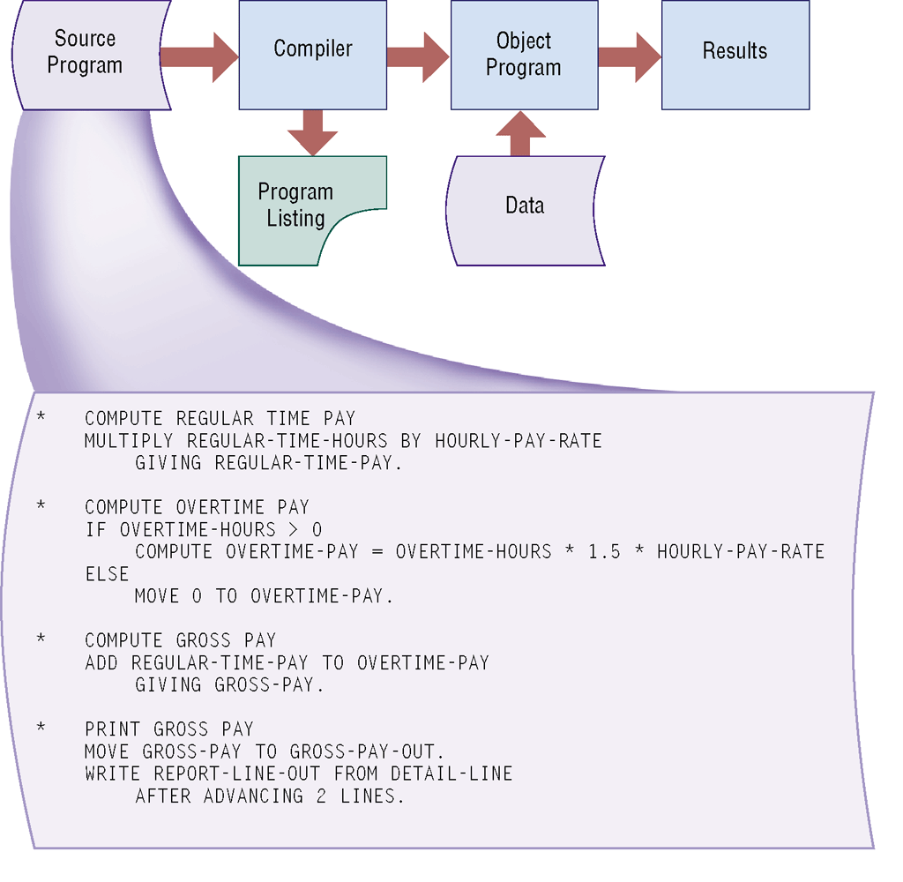
Procedural Languages
What is a compiler?
Program that converts entire source program into machine language before executing it
p. 667 Fig. 13-4
Next

Slide 9
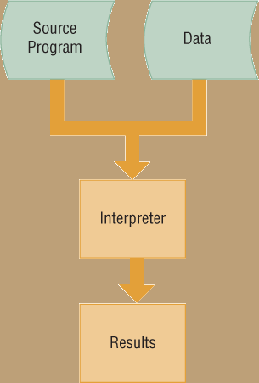
Procedural Languages
What is an interpreter?
Program that translates and executes one program code statement at a time
Does not produce object program
p. 667 Fig. 13-5
Next

Slide 10
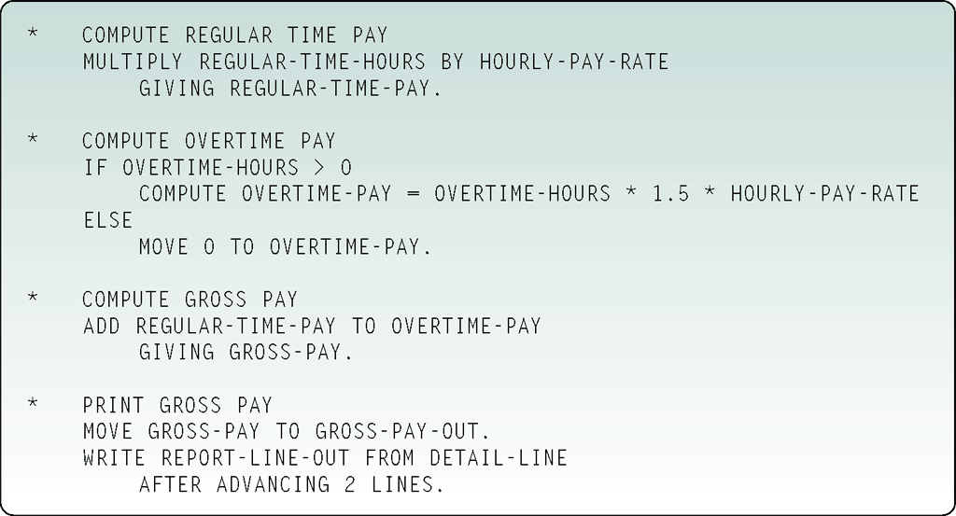
Procedural Languages
What is COBOL?
Designed for business applications
English-like statements make code easy to read, write, and maintain
Common Business-Oriented Language
Click to view Web Link, click Chapter 13, Click Web Link from left navigation, then click COBOL below Chapter 13
p. 668 Fig. 13-6
Next

Slide 11
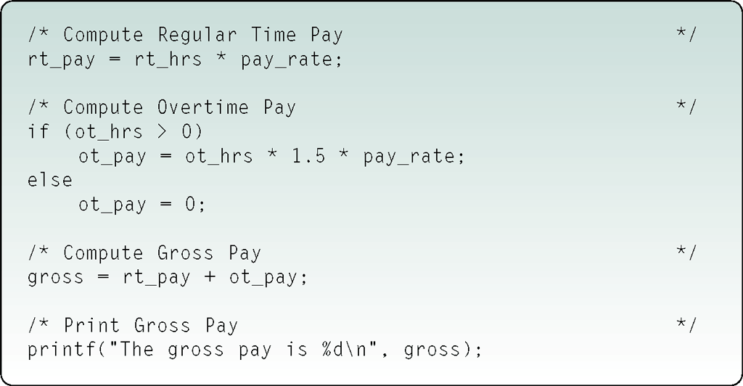
Procedural Languages
What is C?
Powerful language originally designed to write system software
Requires professional programming skills
p. 668 Fig. 13-7
Next

Slide 12
Object-Oriented Programming Languages
What is an object-oriented programming (OOP) language?
Used to implement object-oriented design
Major benefit is ability to reuse and modify existing objects
Event-driven—checks for and responds to set of events
Java, C++, C#, and Visual Basic are complete object-oriented languages
Object is item that contains data and procedures that act on data
Event is action to which program responds
p. 669
Next

Slide 13
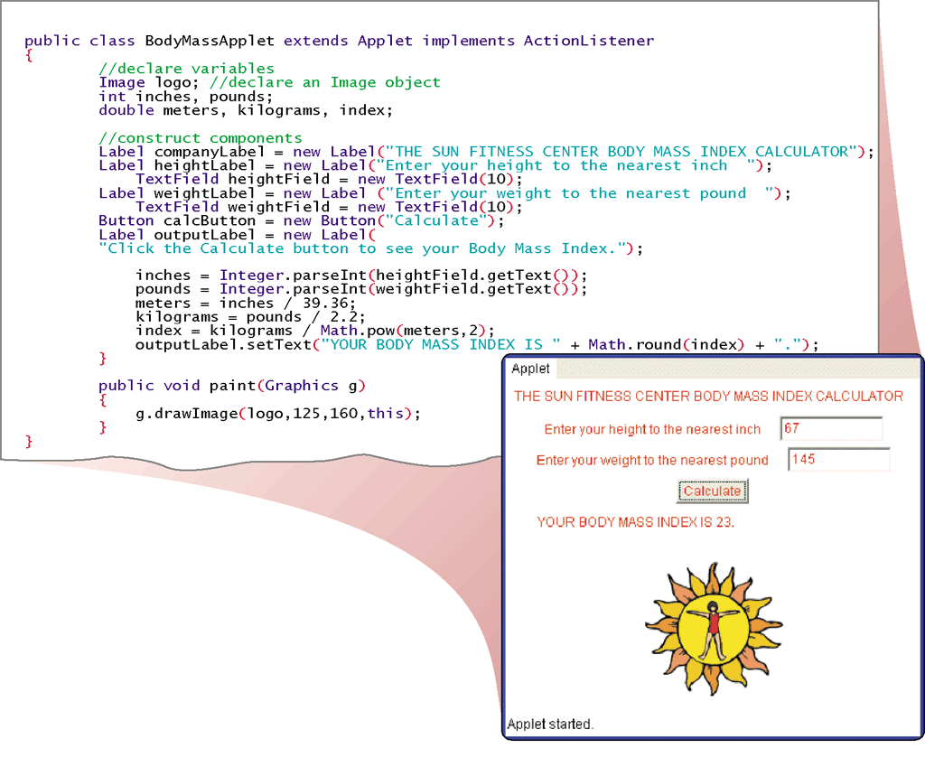
Object-Oriented Programming Languages
What is Java?
Developed by Sun Microsystems
Uses just-in-time (JIT) compiler to convert bytecode into machine-dependent code
Click to view Web Link, click Chapter 13, Click Web Link from left navigation, then click Java Platforms below Chapter 13
p. 669 Fig. 13-8
Next

Slide 14
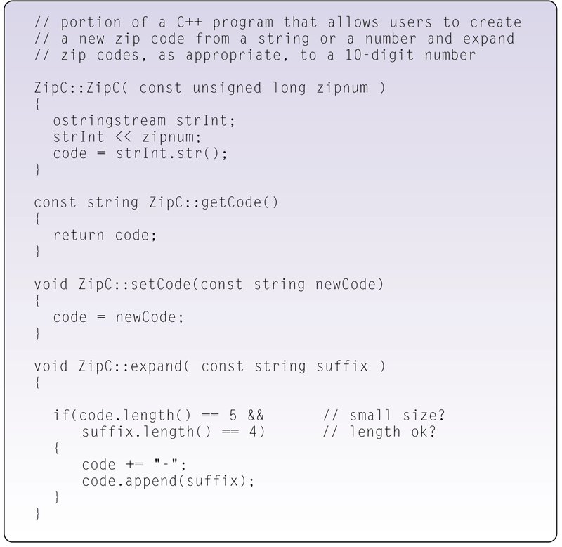
Object-Oriented Programming Languages
What is C++?
Includes all elements of C, plus additional features for working with object-oriented concepts
Used to develop database and Web applications
Click to view Web Link, click Chapter 13, Click Web Link from left navigation, then click C++ below Chapter 13
p. 670 Fig. 13-9
Next

Slide 15
Object-Oriented Programming Languages
What is C#?
Object-oriented programming language based on C++
Accepted as a standard for Web applications and XML-based Web services
Uses a JIT compiler
Resulting code is called Microsoft Intermediate Language (MSIL)
p. 670
Next

Slide 16
Object-Oriented Programming Languages
What is a visual programming language?
Visual programming environment (VPE) allows developers to drag and drop objects to build programs
Provides visual or graphical interface for creating source code
Often used in RAD (rapid application development) environment
Programmer writes and implements program in segments
p. 669 and 673
Next

Slide 17
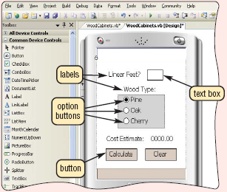
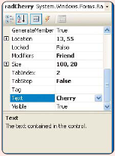
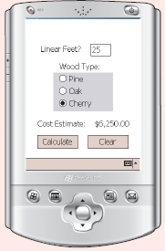
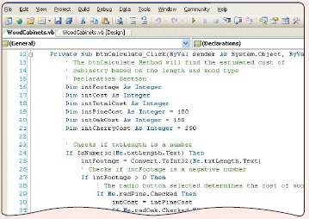
Object-Oriented Programming Languages
What is Visual Studio?
.NET is set of technologies that allows program to run on Internet
Comprised of Visual Basic, Visual C++, and Visual C#
Step 1. The developer designs the user interface.
Step 2. The developer assigns properties to each object on the form.
Step 3. The developer writes code to define the action of each command button.
Click to view Web Link, click Chapter 13, Click Web Link from left navigation, then click Visual Studio Tools for Office below Chapter 13
Step 4. The developer tests the program.
p. 670 - 672 Fig. 13-10
Next

Slide 18
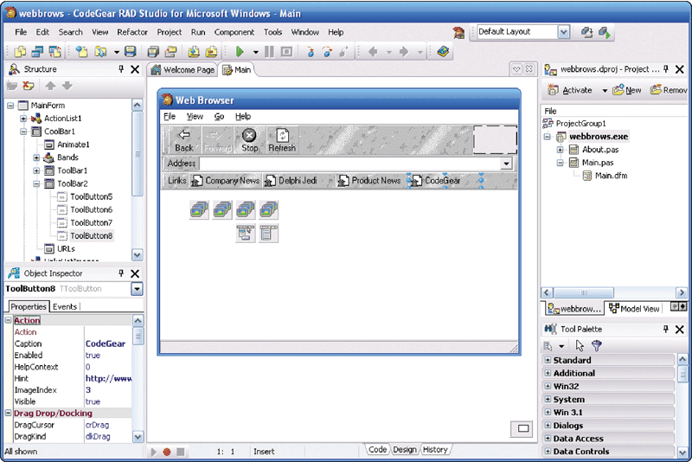
Object-Oriented Programming Languages
What is Delphi?
Powerful program development tool
Ideal for large-scale enterprise and Web applications
p. 672 Fig. 13-11
Next

Slide 19
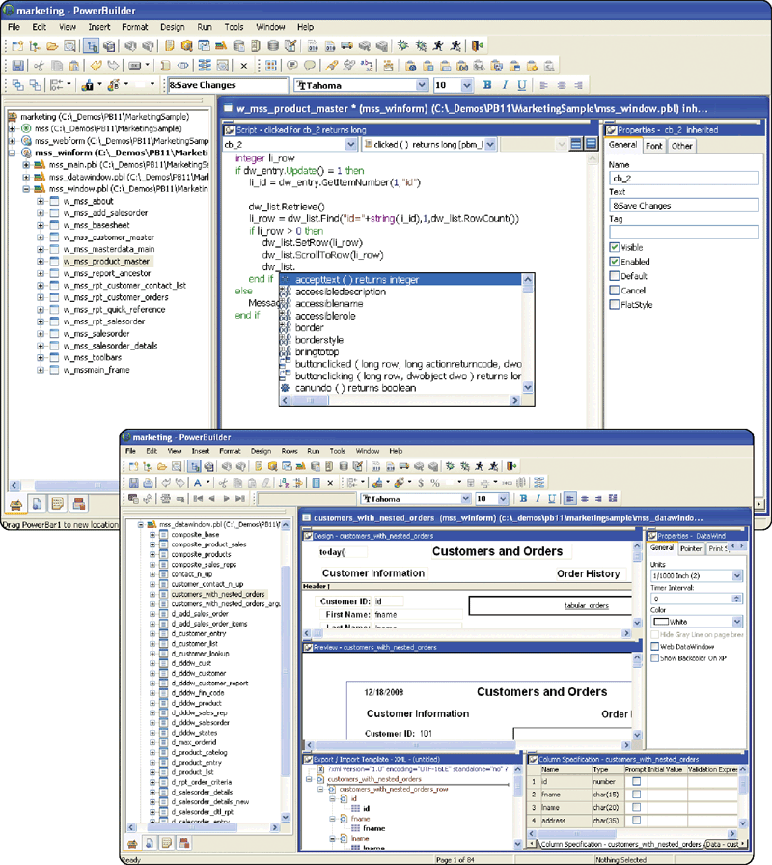
Object-Oriented Programming Languages
What is PowerBuilder?
Another powerful visual programming tool
Best suited for Web-based and large-scale enterprise object-oriented applications
p. 673 Fig. 13-12
Next

Slide 20
Other Programming Languages
What are nonprocedural languages and program development tools?
Nonprocedural Language The programmer writes English-like instructions or interacts with a visual environment to retrieve data from files or a database
Program Development Tools User-friendly programs designed to assist both programmers and users in creating programs
p. 674 and 676
Next

Slide 21
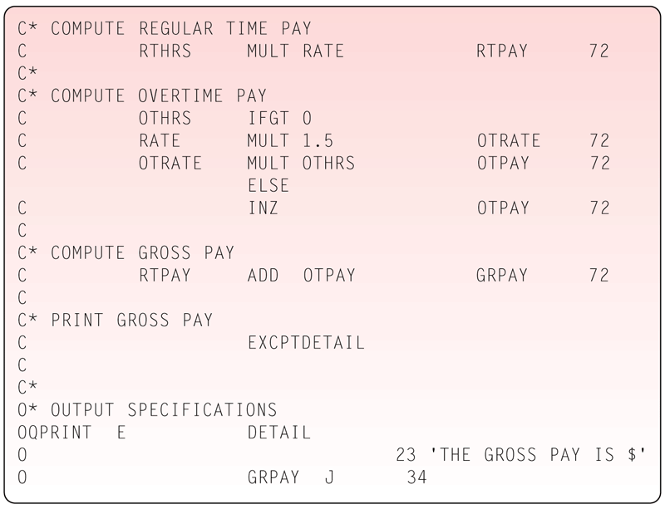
Other Programming Languages
What is RPG (Report Program Generator)?
Nonprocedural language used for generating reports, accessing data, and updating data
p. 674 Fig. 13-13
Next

Slide 22
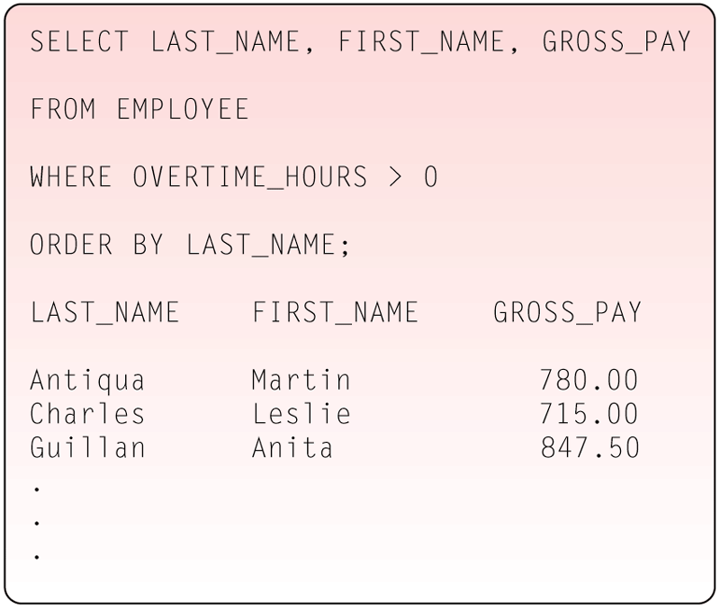
Other Programming Languages
What is a fourth-generation language (4GL)?
Nonprocedural language that allows access to data in database
Popular 4GL is SQL, query language that allows users to manage data in relational DBMS
p. 674 Fig. 13-14
Next

Slide 23
Other Programming Languages
What are other available programming languages?
Ada
ALGOL
APL
BASIC
Forth
FORTRAN
HyperTalk
LISP
Logo
Modula-2
Pascal
PILOT
PL/1
Prolog
Smalltalk
p. 675 Fig. 13-15
Next

Slide 24
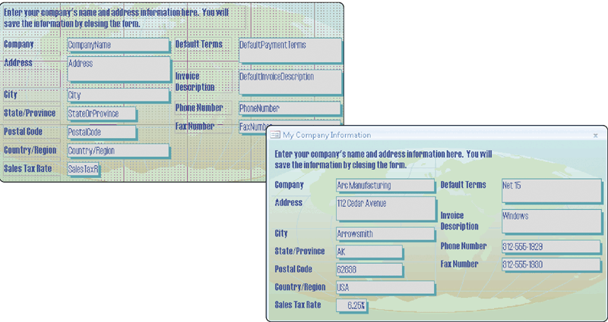
Other Program Development Tools
What is an application generator?
Program that creates source code or machine code from specification
Consists of report writer, form, and menu generator
Form provides areas for entering data
p. 676 Fig. 13-16
Next

Slide 25
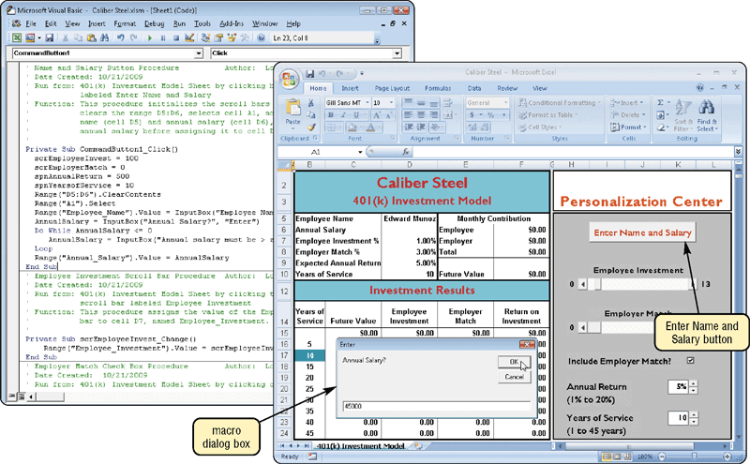
Other Program Development Tools
What is a macro?
Series of statements that instructs an application how to complete a task
Click to view Web Link, click Chapter 13, Click Web Link from left navigation, then click Macros below Chapter 13
p. 676 - 677 Fig. 13-17
Next

Slide 26
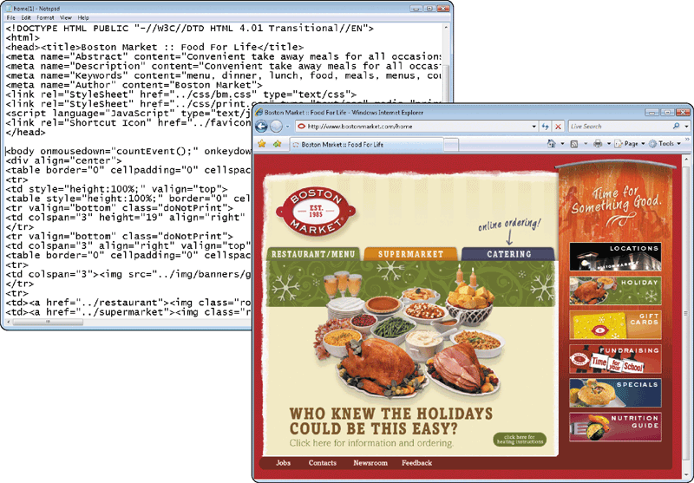
Web Page Development
What is HTML (Hypertext Markup Language)?
Used to create Web pages
p. 678 Fig. 13-18
Next

Slide 27
Web Page Development
How are special effects and interactive elements added to a Web page?
Script interpreted program that runs on client
Applet usually runs on client, but is compiled
Servlet applet that runs on server
ActiveX control small program that runs on client
Counter tracks number of visitors to Web site
Image map graphic image that points to URL
Processing form collects data from visitors to Web site
p. 679
Next

Slide 28
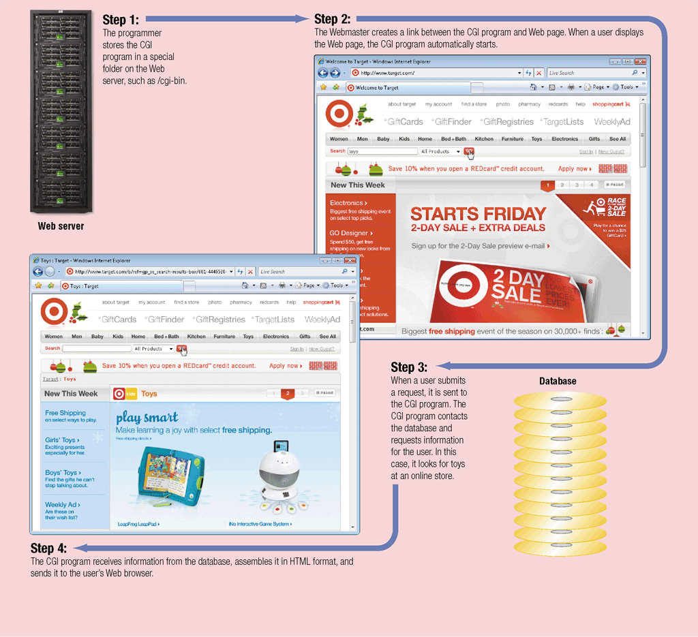
Web Page Development
What is the common gateway interface (CGI)?
Communications standard that defines how Web server communicates with outside sources
CGI script—program that manages sending and receiving across CGI
p.679 - 680 Fig. 13-19
Next

Slide 29
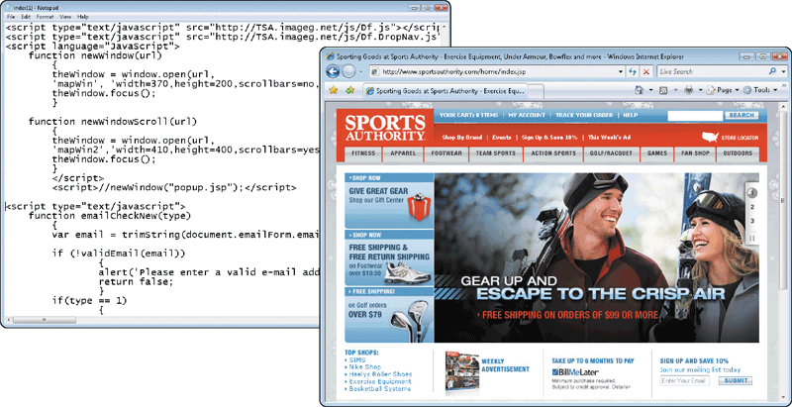
Web Page Development
What is a scripting language?
Typically easy to learn and use
JavaScript
Perl (Practical Extraction and Report Language)
PHP (PHP: Hypertext Preprocessor)
Rexx (Restructured eXtended eXecutor)
TCL (Tool Command Language)
VBScript (Visual Basic, Scripting Edition)
Click to view Web Link, click Chapter 13, Click Web Link from left navigation, then click PHP below Chapter 13
p. 680 - 681 Fig. 13-20
Next

Slide 30
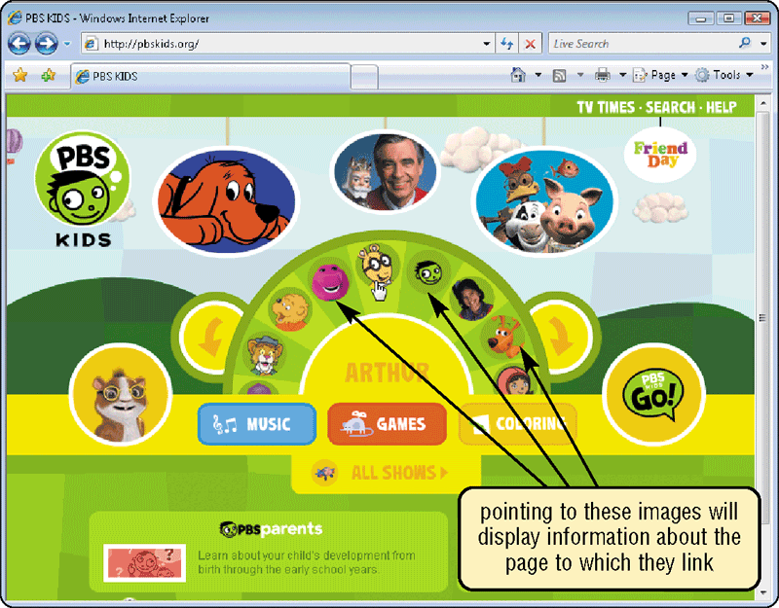
Web Page Development
What is dynamic HTML (DHTML)?
Allows developers to include more graphical interest and interactivity in Web page
Click to view Web Link, click Chapter 13, Click Web Link from left navigation, then click DHTML below Chapter 13
p. 682 Fig. 13-21
Next

Slide 31
Web Page Development
What are XHTML, XML, and WML?
XHTML (Extensible HTML) enables Web sites to be displayed more easily on microbrowsers
Includes features of HTML and XML
XML (Extensible Markup Language) allows developers to create customized tags
Server sends entire record to client, enabling client to do much of processing without going back to server
RSS 2.0 and ATOM
WML (Wireless Markup Language) allows developers to design pages specifically for microbrowsers
Many Internet-enabled smart phones and PDAs use WML as their markup language
p. 682 - 683
Next

Slide 32
Web Page Development
What is Ajax?
Stands for Asynchronous JavaScript and XML
Method of creating interactive Web applications designed to provide immediate response
Combines JavaScript, HTML or XHTML, XML, and cascading style sheets
Google Maps and Flickr use Ajax
p. 683
Next

Slide 33
Web Page Development
What is Ruby on Rails (RoR)?
Also called Rails
Open source framework that provides technologies for developing object-oriented, database-driven Web sites
Ruby is derived from a variety of languages, including Ada, LISP, Perl, and Smalltalk
p. 683
Next

Slide 34
Web Page Development
What is Web page authoring software?
Creates sophisticated Web pages without using HTML
Generates HTML
Dreamweaver
Expression Web
Flash
Silverlight
Click to view Web Link, click Chapter 13, Click Web Link from left navigation, then click Silverlight below Chapter 13
p. 683
Next

Slide 35
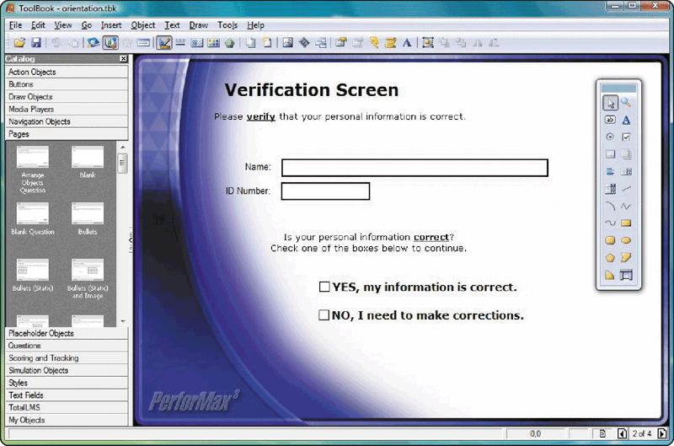
Multimedia Program Development
What is multimedia authoring software?
Combines text, graphics, animation, audio, and video into interactive presentation
Used for computer-based training (CBT) and Web-based training (WBT)
Software includes Toolbook, and Director
p. 684 Fig. 13-22
Next

Slide 36
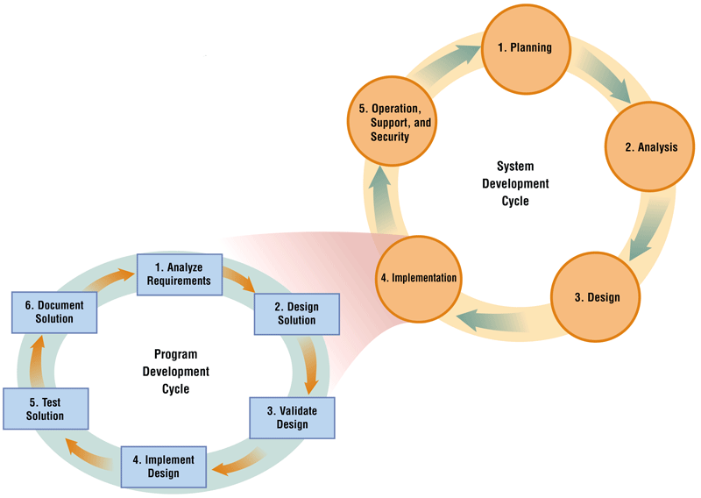
The Program Development Cycle
What is the program development cycle?
Steps programmers use to build computer programs
Programming team—Group of programmers working on program
p. 685 - 686 Fig. 13-23
Next

Slide 37
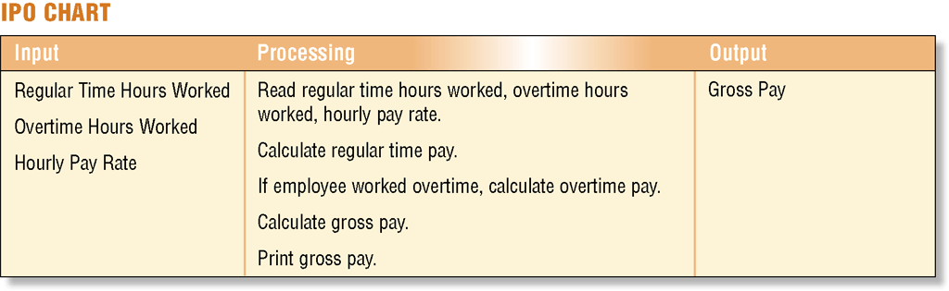
Step 1 — Analyze Requirements
What is involved in analyzing the requirements?
Review requirements
Meet with systems analyst and users
Identify input, output, processing, and data components
IPO chart—Identifies program’s input, processing, and output components
p. 686 - 687 Fig. 13-24
Next

Slide 38
Step 2 — Design Solution
What is involved in designing the solution?
Object-oriented design
Devise solution algorithm, step-by-step procedure to solve problem
Two approaches
Structured design, sometimes called top-down design
Programmer begins with general design and moves toward detailed design
p. 687
Next

Slide 39
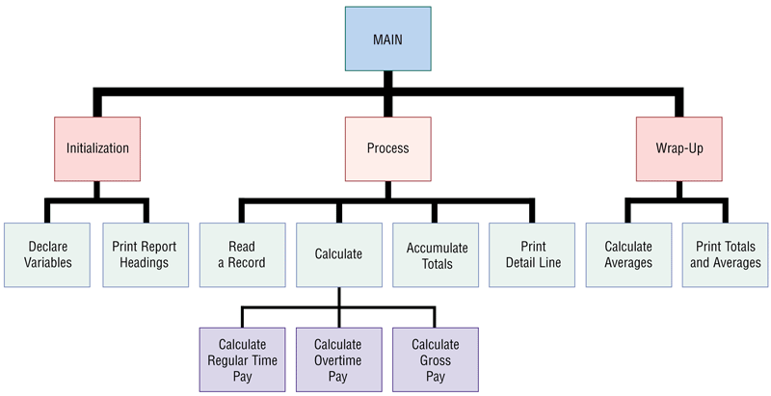
Step 2 — Design Solution
What is a hierarchy chart?
Shows program modules graphically
Also called structure chart
p. 687 Fig. 13-25
Next

Slide 40
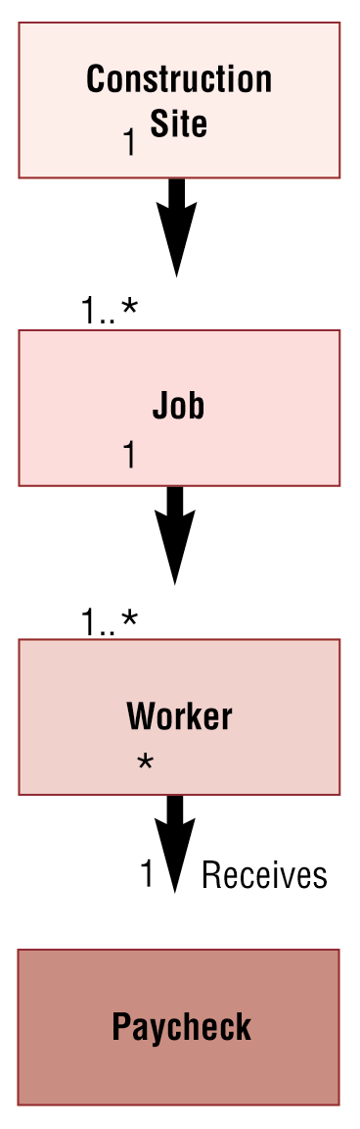
Step 2 — Design Solution
What is object-oriented (OO) design?
Programmer packages data and program into single unit, an object
Objects are grouped into classes
Class diagram represents hierarchical relationships of classes graphically
Click to view Web Link, click Chapter 13, Click Web Link from left navigation, then click Object-Oriented Design below Chapter 13
p. 688 Fig. 13-26
Next

Slide 41
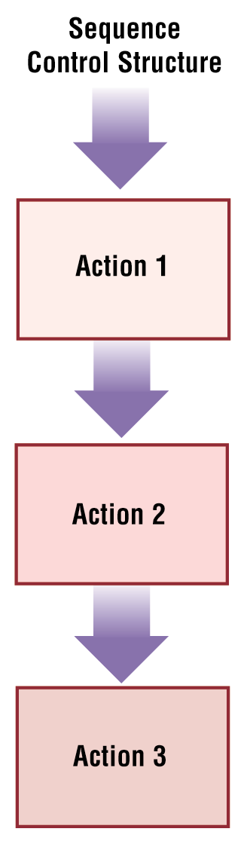
Step 2 — Design Solution
What is a sequence control structure?
Control structure that shows actions following each other in order
Control structure depicts logical order of program instructions
p. 688 Fig. 13-27
Next

Slide 42
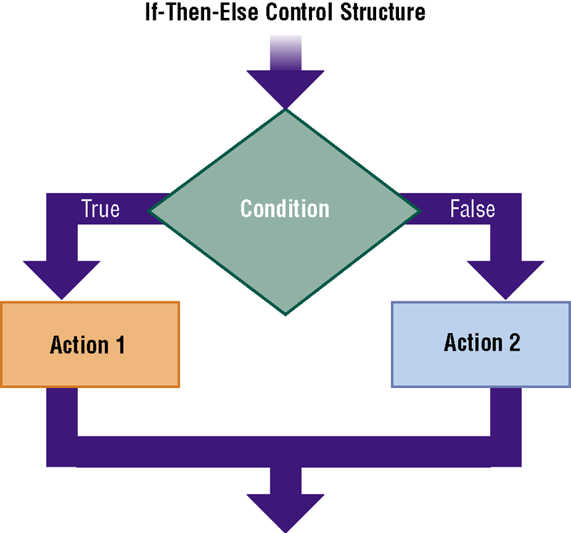
Step 2 — Design Solution
What is a selection control structure?
Tells program which action to take, based on a certain condition
Two types
Case control structure
If-then-else control structure—yields one of two possibilities: true or false
p. 689 Fig. 13-28
Next

Slide 43
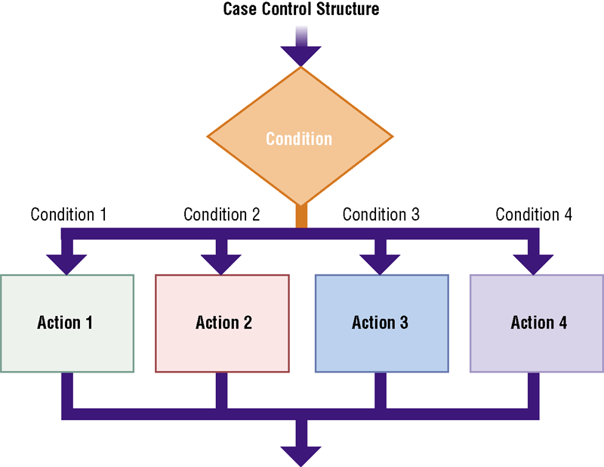
Step 2 — Design Solution
What is a case control structure?
Yields one of three or more possibilities
p. 689 Fig. 13-29
Next

Slide 44
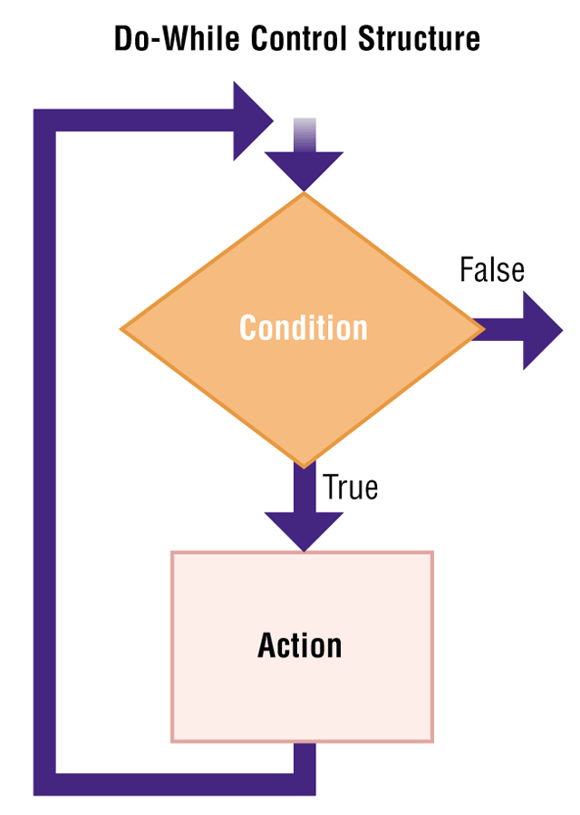
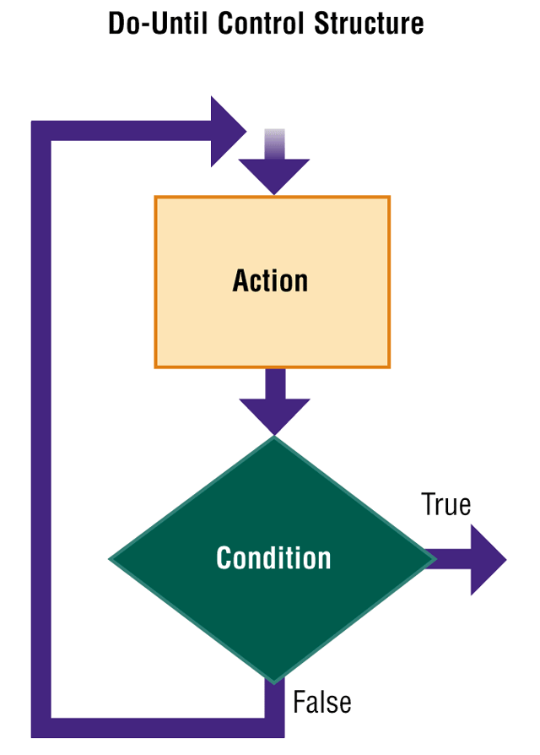
Step 2 — Design Solution
What is a repetition control structure?
Enables program to perform one or more actions repeatedly
Do-while control structure—repeats as long as condition is true
Do-until control structure—repeats until condition is true
p. 689 - 690 Figs. 13-30–13-31
Next

Slide 45
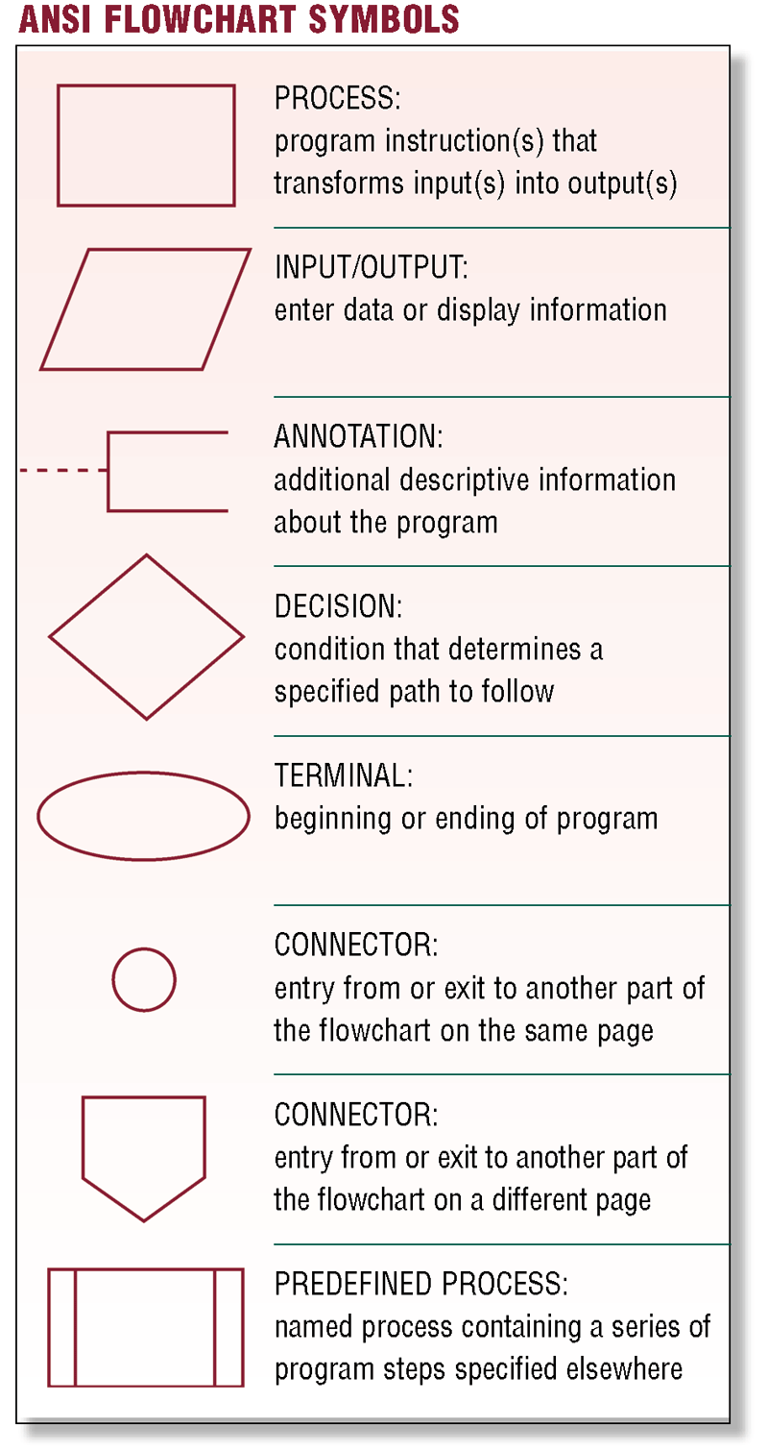
Step 2 — Design Solution
What is a program flowchart?
Graphically shows logic in solution algorithm
p. 690 Fig. 13-32
Next

Slide 46
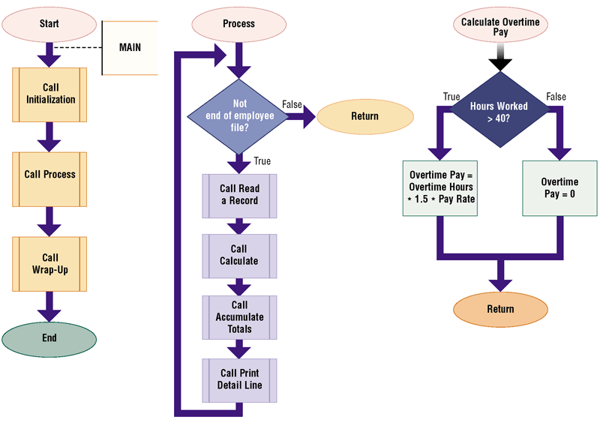
Step 2 — Design Solution
What is an example of a flowchart?
p. 691 Fig. 13-33
Next

Slide 47
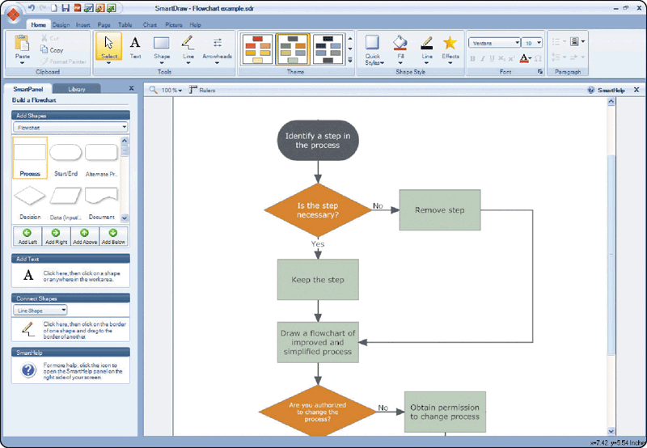
Step 2 — Design Solution
What is flowcharting software?
Used by programmers to develop flowcharts
Click to view Web Link, click Chapter 13, Click Web Link from left navigation, then click Flowcharting Software below Chapter 13
p. 690 - 691 Fig. 13-34
Next

Slide 48
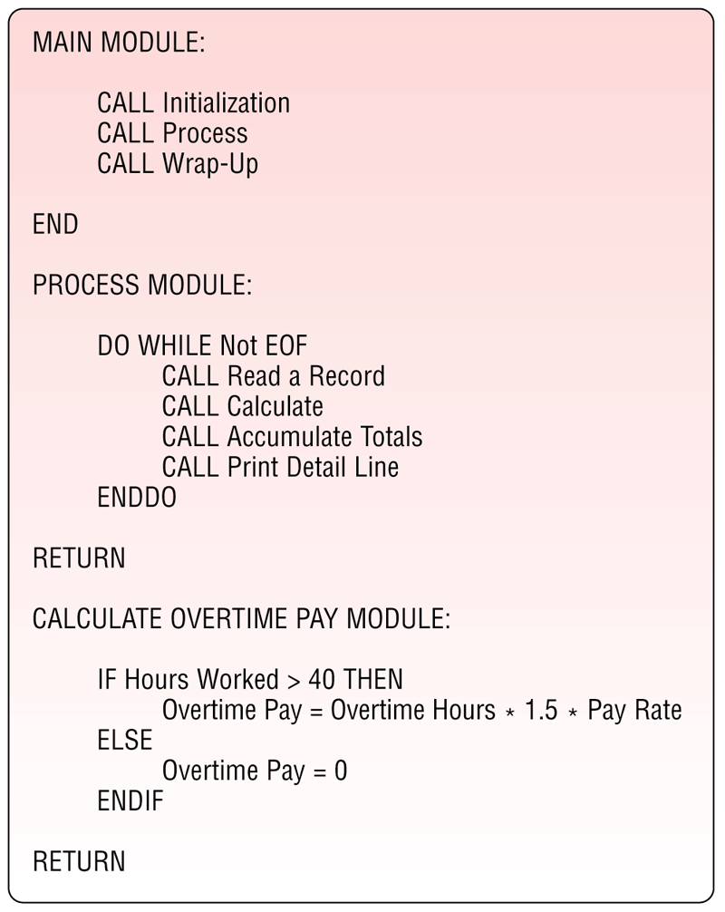
Step 2 — Design Solution
What is pseudocode?
Uses condensed form of English to convey program logic
p. 690 and 692 Fig. 13-35
Next

Slide 49
Step 3 — Validate Design
Check program design for accuracy
Programmer checks logic for correctness and attempts to uncover logic errors
What is involved in validating the design?
Desk check programmers use test data to step through logic
Logic error design flaw that causes inaccurate results
Inspection systems analyst reviews deliverables during the system development cycle
Test data sample data that mimics real data that program will process
p. 693
Next

Slide 50
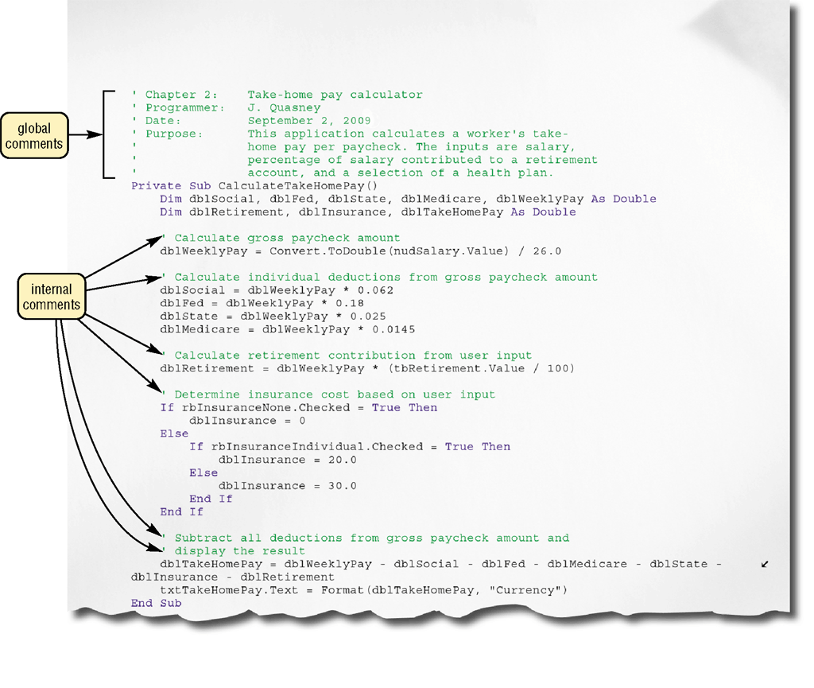
Step 4 — Implement Design
What is implementation?
Writing the code that translates the design into a program
Syntax—rules that specify how to write instructions
Comments—program documentation
Extreme programming (XP)—coding and testing as soon as requirements are defined
p. 693 - 694 Fig. 13-38
Next

Slide 51
Step 5 — Test Solution
What is involved in testing the solution?
Ensure program runs correctly and is error free
Debugging—locating and correcting syntax and logic errors, or bugs
Test copy of program, called beta, sometimes used to find bugs
Click to view Web Link, click Chapter 13, Click Web Link from left navigation, then click Beta Testers below Chapter 13
p. 695 - 696
Next

Slide 52
Step 6 — Document Solution
What is involved in documenting the solution?
Programmer performs two activities
Reviews program code—removes dead code, program instructions that program never executes
Reviews documentation
p. 696
Next

Slide 53

Companies on the Cutting Edge
Video: Electronic Arts Going Mobile
CLICK TO START
Next

Slide 54
Summary of Programming Languages and Program Development
Various programming languages used to create computer programs
Web development and multimedia development tools
The program development cycle and the tools used to make this process efficient
Chapter 13 Complete

